Slide 1
Deep face recognition
Omkar M. Parkhi, Andrea Vedaldi, Andrew Zisserman

Slide 2
Key Questions
Can large scale datasets be built with minimal human intervention?
Can we propose a convolutional neural network which can compete with that of internet giants like Google and Facebook?
Yes!
Yes!

Slide 3
Achievements
New face dataset of 2.6 Million Faces
State of the art results on YouTube faces in the wild dataset
Comparable to the state of the art results on the Labeled faces in the wild dataset

Slide 4
Can large scale datasets be built with minimal human intervention?

Slide 5


Dataset Collection
Candidate list generation: Finding names of celebrities
Tap the knowledge on the web
5000 identities
Robert Downey Jr.
Allison Hannigan
Ashley Hamilton
Amitabh Bacchan
Barack Obama
Vladimir Putin

Slide 6

Dataset Collection
Manual verification of celebrities: Finding Popular Celebrities
Collect representative images for each celebrity
200 images/identity
Remove people with low representation on Google.
Remove overlap with public benchmarks
2622 celebrities for the final dataset

Slide 7
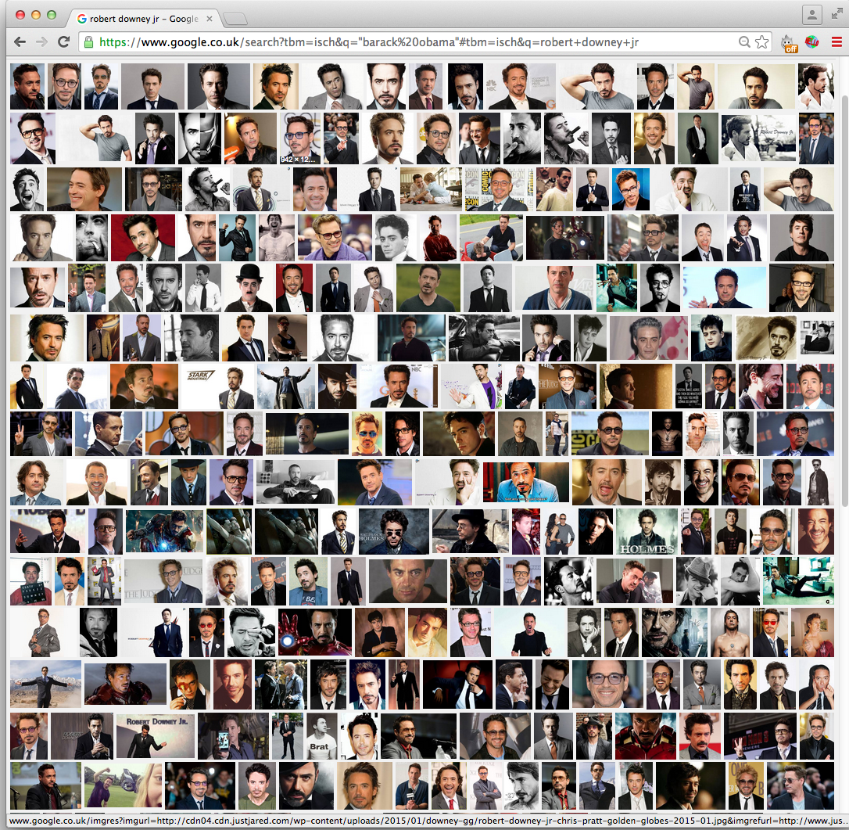
Dataset Collection
Popular Celebrity
Robert Downey Jr.

Slide 8
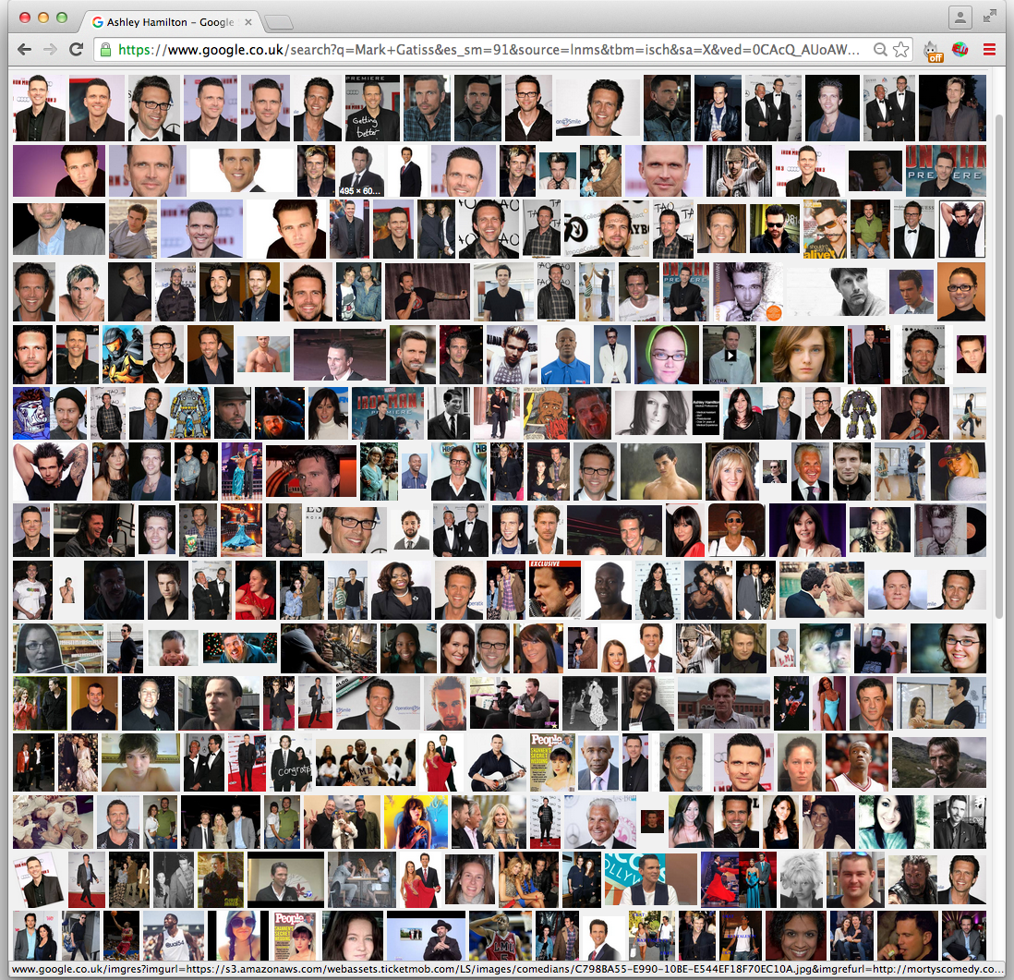
Dataset Collection
Not so popular
celebrity
Ashley Hamilton

Slide 9
Dataset Collection
Manual verification of celebrities: Finding Popular Celebrities
Collect representative images for each celebrity
200 images/identity
Remove people with low representation on Google.
Remove overlap with public benchmarks
2622 celebrities for the final dataset

Slide 10

Dataset Collection
Rank image sets
2000 images per identity
Searching by appending keyword “actor”
Learning classifier using data obtained the previous step. c
Ranking 2000 images and selecting top 1000 images
Approx. 2.6 Million images of 2622 celebrities

Slide 11
Dataset Collection
Near duplicate removal
VLAD descriptor based near duplicate removal
manual filtering
Curating the dataset further using manual checks
No. | Aim | Mode | # Persons | # images /person | Total # images | Anno. effort
1 | Candidate list generation | Auto | 5000 | 200 | 1,000,000 | -
2 | Candidate list filtering | Manual | 2622 | - | - | 4 days
3 | Rank image sets | Auto | 2622 | 1000 | 2,622,000 | -
4 | Near duplicate removal | Auto | 2622 | 623 | 1,635,159 | -
5 | Manual filtering | Manual | 2622 | 375 | 982,803 | 10 days

Slide 12
Dataset Collection
Dataset Comparison
No. | Aim | # Persons | Total # images
1 | Labeled Faces In the Wild | 5,749 | 13,233
2 | WDRef | 2995 | 99,773
3 | Celeb Faces | 10177 | 202,599
4 | Ours | 2622 | 1,635,159
5 | Facebook | 4030 | 4.4M
6 | Google | 8M | 200M

Slide 13
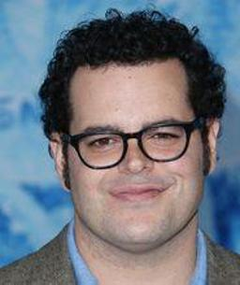
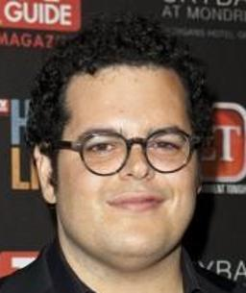


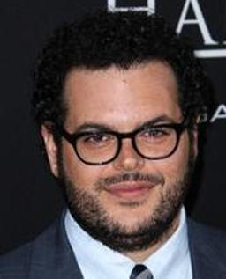
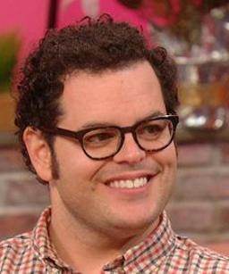
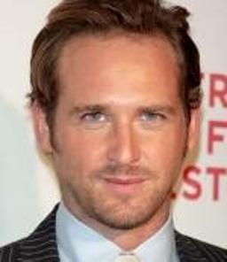

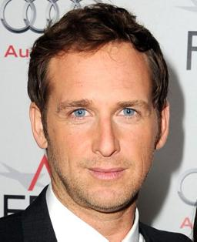

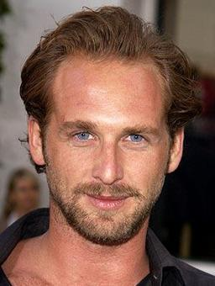
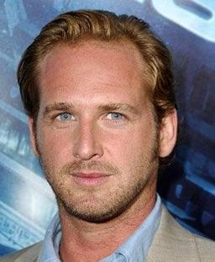
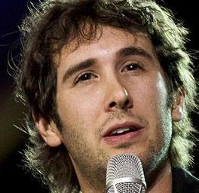
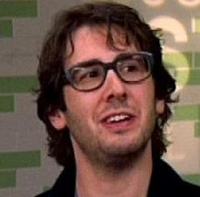
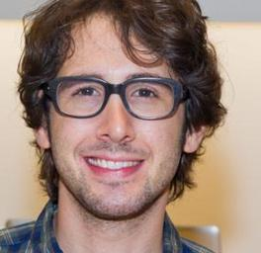

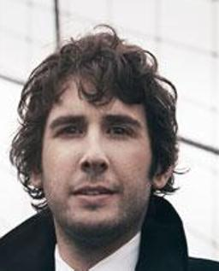
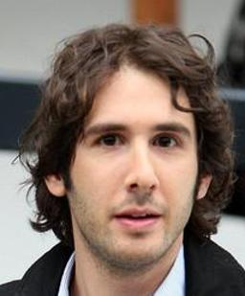







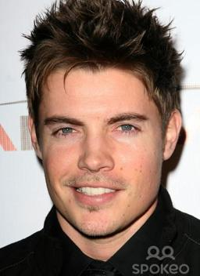
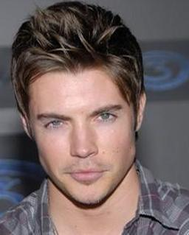
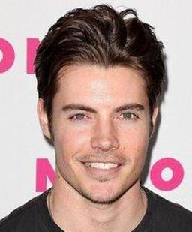
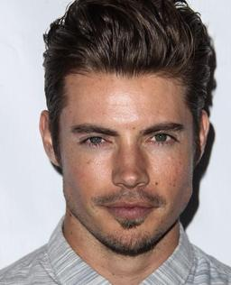
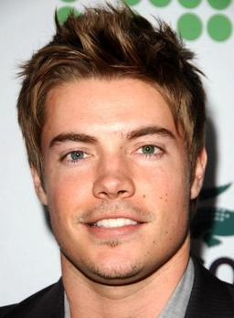

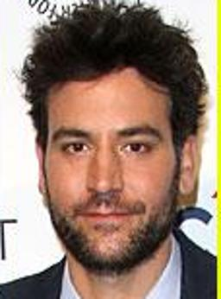

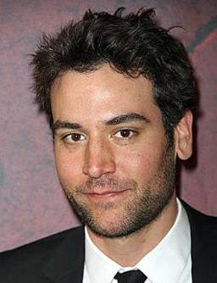
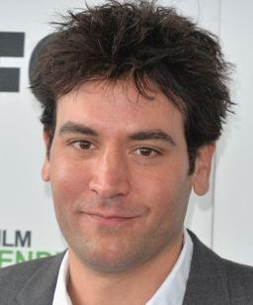

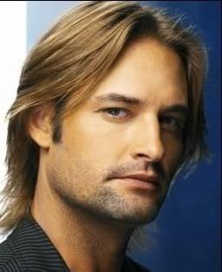
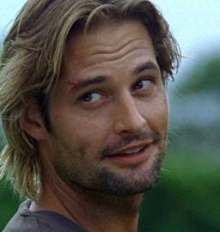
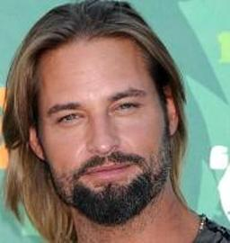
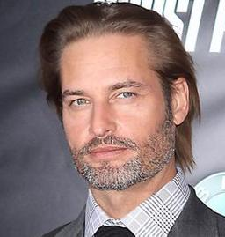







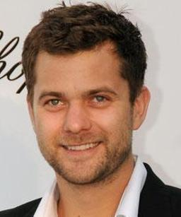
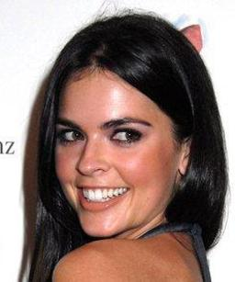
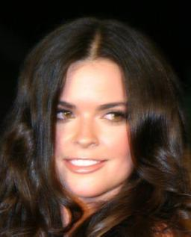
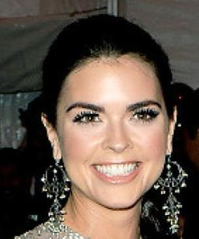
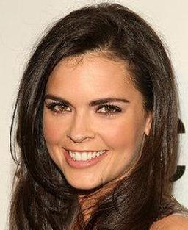
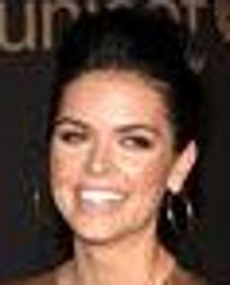
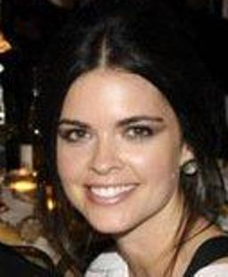

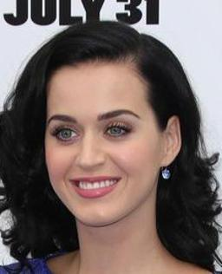
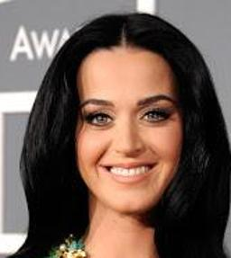
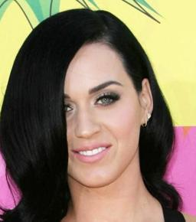
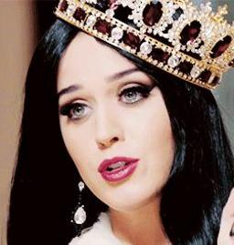
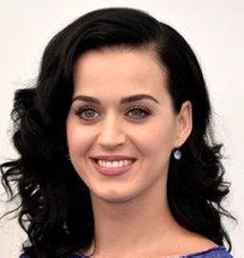
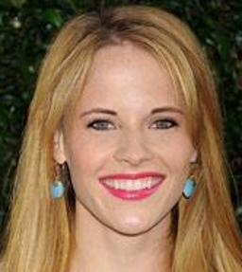
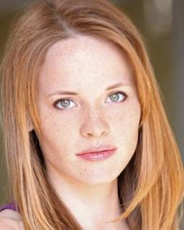
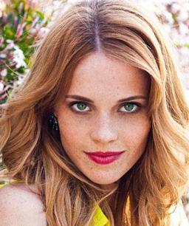
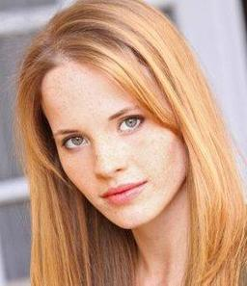
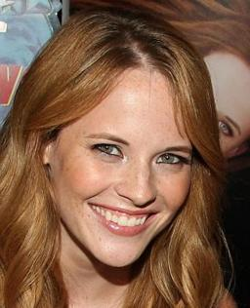
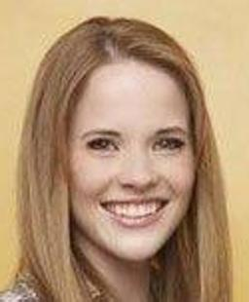
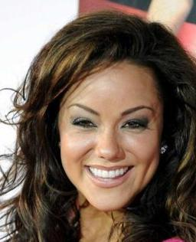
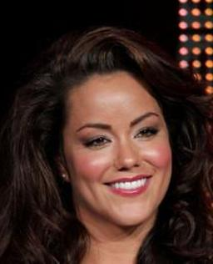
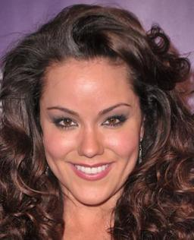

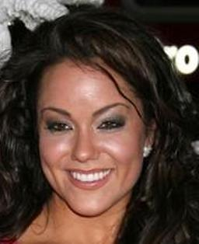
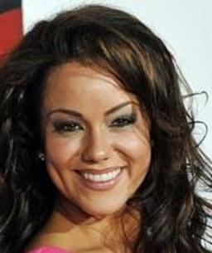












Dataset Collection
Example Images From Our Dataset

Slide 14
Can we propose a convolutional neural network which can compete with that of internet giants like Google and Facebook etc.?

Slide 15
Convolutional Neural Network
image
Conv-64
Conv-64
maxpool
The “Very Deep” Architecture
Different from previous architectures proposed
for face recognition:
locally connected layers (Facebook)
inception (Google)
Network Details:
3 x 3 Convolution Kernels (Very small)
Conv. Stride 1 px.
Relu non-linearity
No local contrast normalisation
3 Fully connected layers
Conv-128
Conv-128
maxpool
Conv-256
Conv-256
maxpool
Conv-512
Conv-512
Conv-512
maxpool
Conv-512
Conv-512
Conv-512
maxpool
fc-4096
fc-4096
fc-2622
Very Deep Convolutional Networks for large-Scale Image Recognition.
K. Simonyan and A. Zisserman.
Softmax

Slide 16
Convolutional Neural Network
image
Conv-64
Conv-64
Training
MatConvNet Tootlbox
Nvidia CuDNN bindings
Multi GPU Training (approx 3.5x speedup)
Nvidia Titan Black
7 days of training
Random Gaussian Initialization
Stochastic Gradient Descent with back prop.
Accumulator Descent for large batch sizes
Batch Size: 256
Incremental FC layer training
2622 way multi class criterion (soft max)
maxpool
Conv-128
Conv-128
maxpool
Conv-256
Conv-256
maxpool
Conv-512
Conv-512
Conv-512
maxpool
Conv-512
Conv-512
Conv-512
maxpool
fc-4096
fc-4096
Matconvnet – convolutional neural networks for matlab.
A Vedaldi and K. Lenc. Arxiv - 2014.
fc-2622
Softmax

Slide 17
Convolutional Neural Network
Training: Learning Task Specific Embedding
Learning embedding by minimizing triplet loss
Learning a projection from 4096 to 1024 dimensions
On line triplet formation at the beginning of each iteration
Fine tuned on target datasets
Only the projection layers learnt

Slide 18
Design Choices
Network configuration
Does increasing the depth improves performance?
Face alignment
Can the network be invariant to changes in the faces?
Task specific learning
What are the effects of task specific embedding learning on performance?

Slide 19

Labeled Faces In the Wild Dataset (LFW)
Face Verification: Given a pair of images specify
whether they belong to the same person
13K images, 5.7K people
Standard benchmark in the community
Several test protocols depending upon availability of training data
within and outside the dataset.
[ G. Huang, M. Ramesh, T. Berg and E. Learned-Miller - Tech Report 07]

Slide 20
Effects of design choices (LFW Unrestricted Protocol)
No. | Network Config. | Dataset | Face Align Training | Face Align Testing | Embedding | 100%-EER
1 | A | Curated | No | No | No | 92.83
2 | A | Full | No | No | No | 95.80
3 | A | Full | No | Yes | No | 96.70
4 | B | Full | No | Yes | No | 97.72
5 | B | Full | Yes | Yes | No | 97.07
6 | D | Full | No | Yes | No | 96.60
7 | B | Full | No | Yes | Yes | 99.13

Slide 21
Comparison with the State of the Art (LFW Unrestricted Protocol)
No. | Method | # Training Images | # Networks | Accuracy
1 | Fisher Vector Faces | - | - | 93.10
2 | DeepFace | 4 M | 3 | 97.35
3 | DeepFace Fusion | 500 M | 5 | 98.37
4 | DeepID-2,3 | Full | 200 | 99.47
5 | FaceNet | 200 M | 1 | 98.87
6 | FaceNet+ Alignment | 200 M | 1 | 99.63
7 | VGG Face | 2.6 M | 1 | 98.95

Slide 22




YouTube Faces Dataset (YTF)
Video Face Verification: Given a pair of videos specify
whether they belong to the same person
3425 videos, 1595 people
Standard benchmark in the community
Wide pose, expression and illumination variation
same
different
[Wolf, Hassner, Moaz CVPR 2011]

Slide 23
Comparison with the State of the Art (YTF Unrestricted Protocol)
No. | Method | # Training Images | # Networks | 100%-EER | Accuracy
1 | Video Fisher Vector Faces | - | - | 87.7 | 93.10
2 | DeepFace | 4 M | 1 | 91.4 | 91.4
4 | DeepID-2,2+,3 |  | 200 | - | 93.2
5 | FaceNet + Alignment | 200 M | 1 | - | 95.1
7 | VGG Face | 2.6 M | 1 | 97.4 | 97.3

Slide 24

Oxford Buffy Dataset
“Buffy The Vampire Slayer”
Face tracks from 7 episodes of season 5.
Both frontal and profile detections
Weak supervision from transcript and subtitles
Multi Class classification for every episode
Weakly supervised face classification
[Everingham et al. IVC 2009, Sivic et al. CVPR 2009]

Slide 25
Comparison with the State of the Art (Oxford Buffy Dataset)
No. | Method | Mean AP
1 | Sivic et. al (HOG + RBF SVM) | 0.81
2 | Video Fisher Vector Faces (FV + Lin SVM) | 0.86
3 | Ours (CNN + MIL SVM) | 0.95

Slide 26


Deep Face Dreams
Inversion by maximizing class specific neuron responses
Representative Image
Neuron Inversion
[Simonyan et al. NIPS 2014, Mahendran et al. CVPR 2015]

Slide 27


Deep Face Dreams
Inversion by maximizing class specific neuron responses
Representative Image
Neuron Inversion
[Simonyan et al. NIPS 2014, Mahendran et al. CVPR 2015]

Slide 28


Deep Face Dreams
Inversion by maximizing class specific neuron responses
Representative Image
Neuron Inversion
[Simonyan et al. NIPS 2014, Mahendran et al. CVPR 2015]

Slide 29


Deep Face Dreams
Inversion by maximizing class specific neuron responses
Representative Image
Neuron Inversion
[Simonyan et al. NIPS 2014, Mahendran et al. CVPR 2015]

Slide 30
Thank You!

